Slide 1

EC1002-2: Applied Digital Logic Design
Department of Electronics and Communication Engineering

Slide 2
Unit II
Combinational Logic and Sequential Logic Circuits

Slide 3

UNIT – II
Combinational Logic and Sequential Logic Circuits: Introduction to Combinational Logic Circuits, Half/Full Adders/Subtractors, Parallel Adders/Subtractors, Binary Comparators, Decoders, Encoders, Multiplexers. Basic Bistable Element, SR Flip-Flop, D Flip Flop, JK Flip Flop, T Flip Flop, Master Slave JK Flip Flop, Characteristic Equations, Conversion of Flip Flops.
10Hrs
3

Slide 4
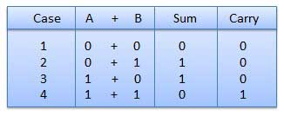
Binary addition

Slide 5
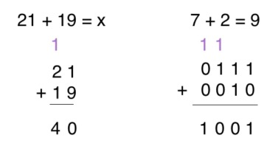
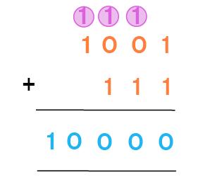

Slide 6
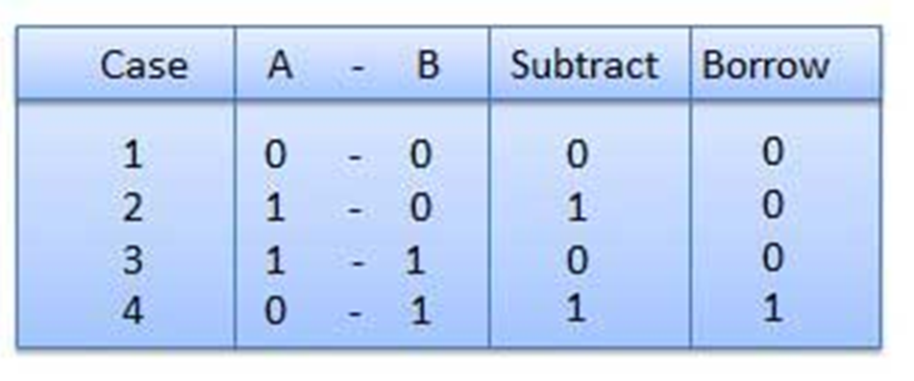
Binary subtraction
1

Slide 7
Binary subtraction using 2’s complement method
2’s complement is a complement arithmetic operation used to find the complement of a given number.
The 2’s complement of a binary number is determined by taking 1’s complement of the given number and then adding a 1 to the least significant bit of the 1’s complement.
1’s complement is an arithmetic operation that performs the inversion of bits of a binary number.
The 1’s complement of a binary number is determined by changing all the bits to 0 and 0 bits to 1 of the number.

Slide 8
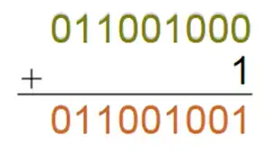
For example, consider the binary number (100110111)₂.
We have to find the 2’s complement of this number.
Firstly, we find the 1’s complement of this number below.
1’s Complement = (011001000)₂
Now, as follows, add 1 to the LSB of 1’s complement to determine the 2’s complement of the number.

Slide 9
Binary number subtraction using 2’s complement
The following steps are involved in subtraction using the 2’s complement arithmetic.
Find the 2’s complement of the subtrahend.
Add the 2’s complement of the subtrahend to the minuend.
If there is a carry produced, the result is positive. Obtain the final result by omitting the carry.
If there is no carry produced, the result is negative. The final result is obtained by taking 2’s complement of the intermediate result and putting a minus sign.

Slide 10
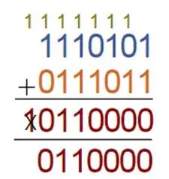
Subtract (1110101)₂ – (1000101)₂ using 2’s complement arithmetic.
Minuend = (1110101)₂
Subtrahend = (1000101)₂
1’s complement of subtrahend = (0111010)₂
Therefore, 2’s complement of subtrahend = (0111010)₂ + (1)₂ = (0111011)₂
Adding 2’s complement of the subtrahend to minuend to obtain to perform their subtraction.
(1110101)₂ + (0111011)₂ = (1 0110000)₂
Since there is a carry, hence the result is positive. The final result is obtained by discarding the carry marked in red.

Slide 11
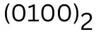
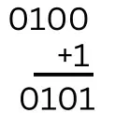
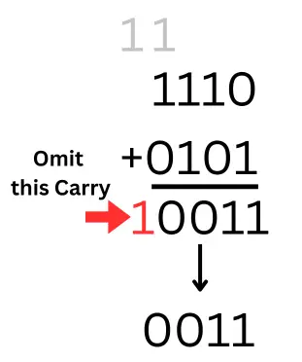
Subtract (1011) ₂ from (1110) ₂ using 2’s complement method
In this example, Subtrahend (1011) ₂ is the smaller than Minuend number (1110) ₂.
Step 1– 1’s complement of subtrahend (1011) ₂
Step 2– 2’s complement of number (step 1)
Step 3– Add (1110) ₂ and (0101) ₂

Slide 12
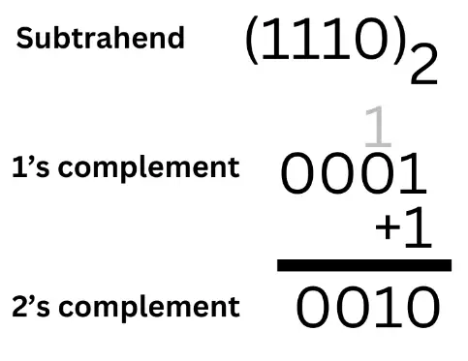
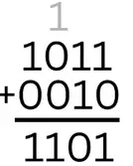
Perform (1011)₂ - (1110)₂ from using 2’s complement method
Subtrahend (1110) ₂ is larger than Minuend number (1011)₂ in this example.
Step 1– 2’s complement of number (1110)2
Step 2– Add minuend (1011) ₂ and 2’s complement of subtrahend (0010) ₂

Slide 13
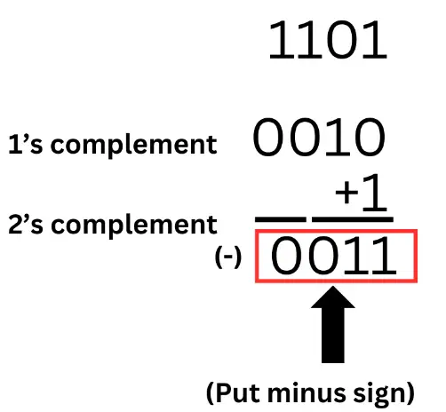
Step 3– No carry generated, Take 2’s complement of the number obtained in Step 2

Slide 14
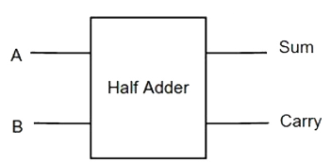
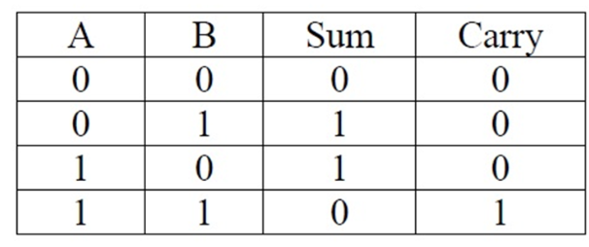
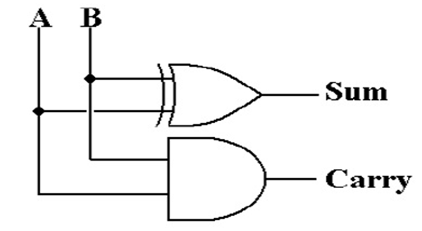
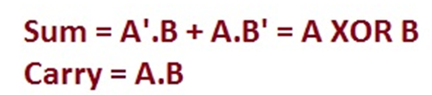
Half Adder
Half Adder adds to one-bit numbers and produces two outputs sum and Carry

Slide 15
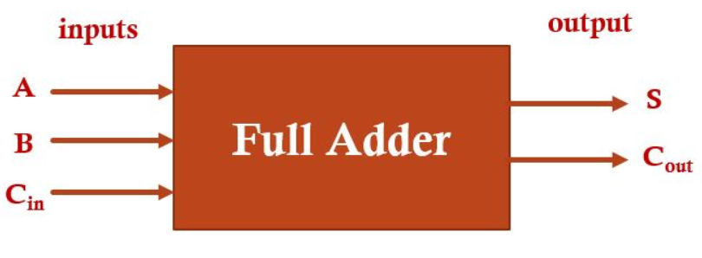
Full Adder
A full adder is a combinational logic circuit that performs the addition of three single-bit numbers.
It is a digital circuit that has three inputs A, B, and C_{in} , where C_{in} is the previous carry and two output sum (S), carry (C_{out}).
Here sum is the least significant bit (LSB) and carry is the most significant bit (MSB).
A full adder circuit is used in computer ALU (Arithmetic and Logic Unit ) to perform arithmetic operations.

Slide 16
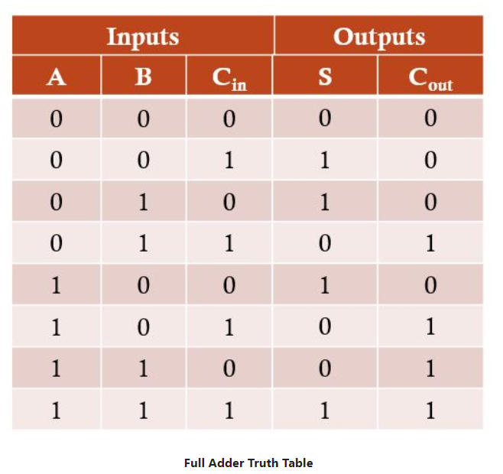
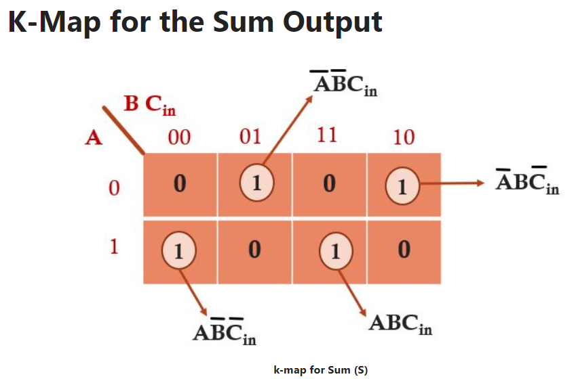
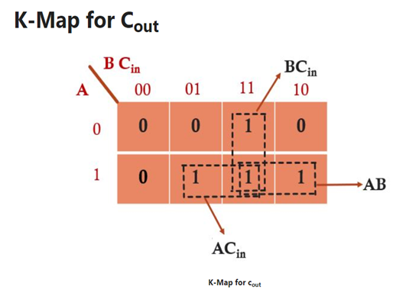

Slide 17

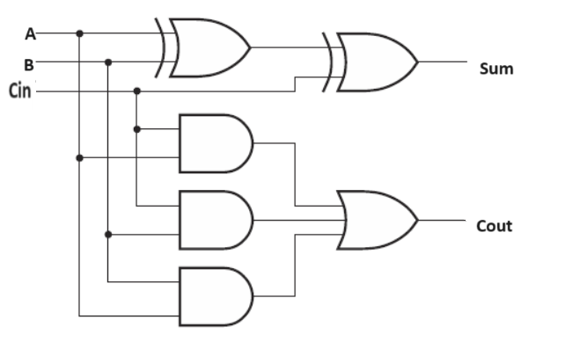
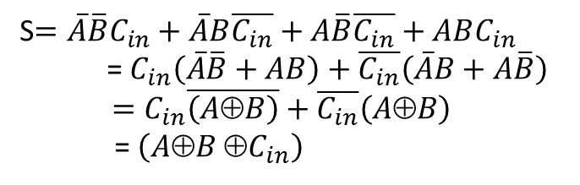
S$=\overline{A}\overline{B}C_{in}+\overline{A}B\overline{C_{in}}+A\overline{B}\overline{C_{in}}+ABC_{in}$
= $C_{in}\left(\overline{A}\overline{B}+AB\right)+\overline{C_{in}}\left(\overline{A}B+A\overline{B}\right)$
$=C_{in}\overline{\left(A⊕B\right)}+\overline{C_{in}}\left(A⊕B\right)$
= $\left(A⊕B ⊕C_{in}\right)$

Slide 18
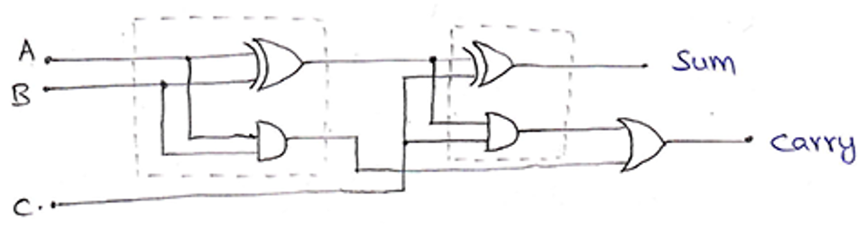
Full adder using half adder

Slide 19
Sum = A ⊕ B ⊕ C
Carry = AB + (A ⊕ B)C
= AB + (A’B + AB’)C
= AB + A’BC + AB’C
= B (A + A’C) + AB’C
= B [(A + A’)(A + C)] + AB’C
= AB + BC + AB’C
= BC + A(B + B’C)
= BC + A[(B + B’)(B + C)]
= BC + AB + AC
= AB + BC + AC

Slide 20
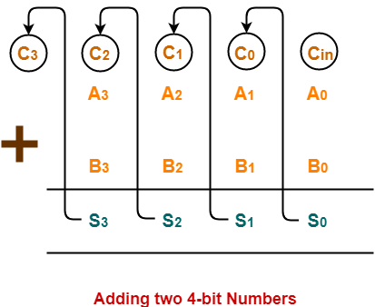
4-bit ripple carry adder
1 1 0 0 0
1 1 0 1
1 1 0 0
1 1 0 0 1

Slide 21
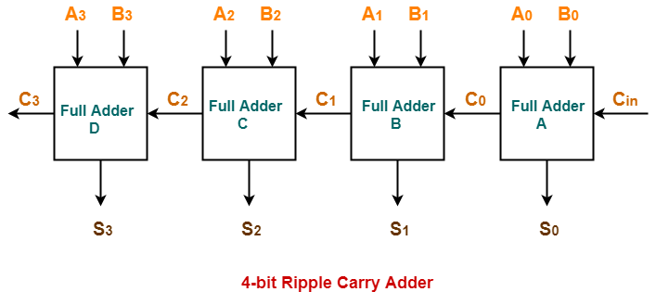
4-bit ripple carry adder/Parallel adder
C3 = Cout

Slide 22
Working of Ripple Carry Adder /Parallel adder
Firstly the Full Adder A adds A0 and B0 along with the carry Cin to generate the sum S0 (the first bit of the output sum) and the carry C0 which is connected to the next adder in chain.
Next, the Full Adder B uses this carry bit C0 to add with the input bits A1 and B1 to generate the sum S1(the second bit of the output sum) and the carry C1 which is again further connected to the next adder in chain and so on.
The process continues till the last Full Adder D uses the carry bit C2 to add with its input A3 and B3 to generate the last bit of the output S3 along with last carry bit C3.

Slide 23
A3 A2 A1 A0 → 0101
B3 B2 B1 B0 → 1010
Cin→0
------------------------------
S3S2S1S0→1111
C3→0

Slide 24
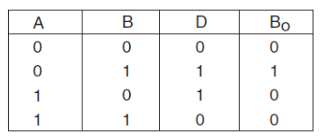
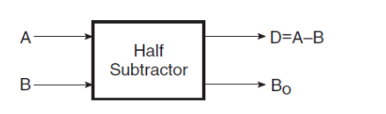
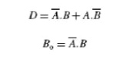
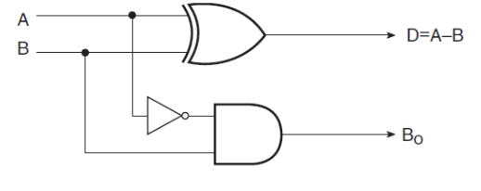
Half Subtractor
It produces the difference between the two binary bits at the input and produces two outputs difference and borrow ( to indicate if a 1 has been borrowed)
In the subtraction (A), A is called a Minuend bit and B is called a Subtrahend bit.
= A XOR B

Slide 25
Full Subtractor
A full subtractor is a combinational circuit that performs subtraction of two bits, one is minuend and other is subtrahend, taking into account borrow of the previous adjacent lower minuend bit. This circuit has three inputs and two outputs.
The three inputs A, B and Bin, denote the minuend, subtrahend, and previous borrow, respectively. The two outputs, D and Bout represent the difference and output borrow, respectively.

Slide 26
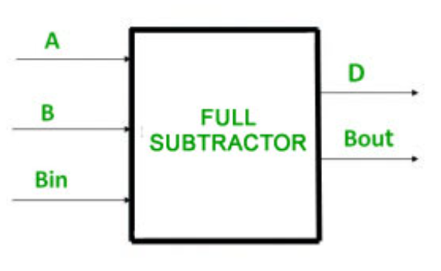
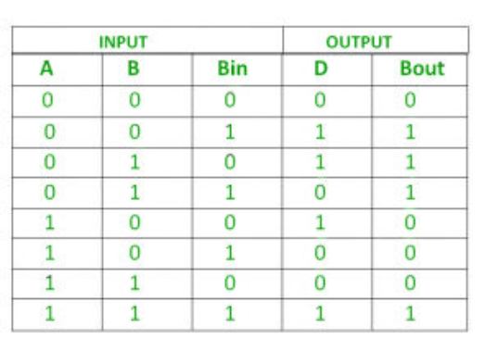

Slide 27
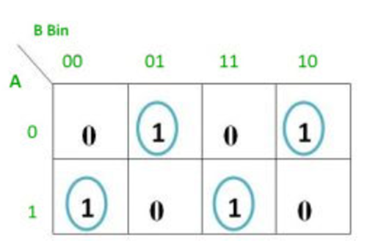
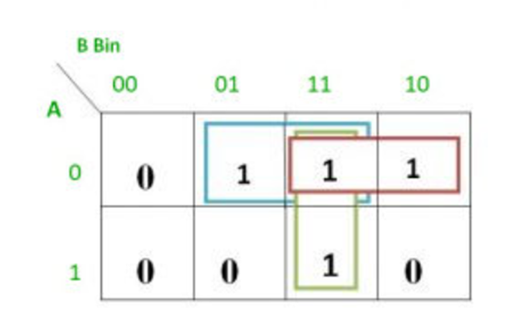
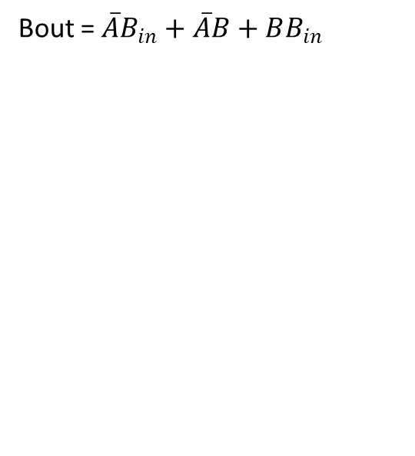
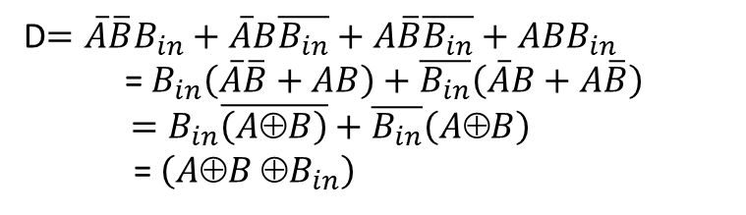
D
Bout
Bout = $\overline{A}B_{in}+\overline{A}B+BB_{in}$
D$=\overline{A}\overline{B}B_{in}+\overline{A}B\overline{B_{in}}+A\overline{B}\overline{B_{in}}+ABB_{in}$
= $B_{in}\left(\overline{A}\overline{B}+AB\right)+\overline{B_{in}}\left(\overline{A}B+A\overline{B}\right)$
$=B_{in}\overline{\left(A⊕B\right)}+\overline{B_{in}}\left(A⊕B\right)$
= $\left(A⊕B ⊕B_{in}\right)$

Slide 28
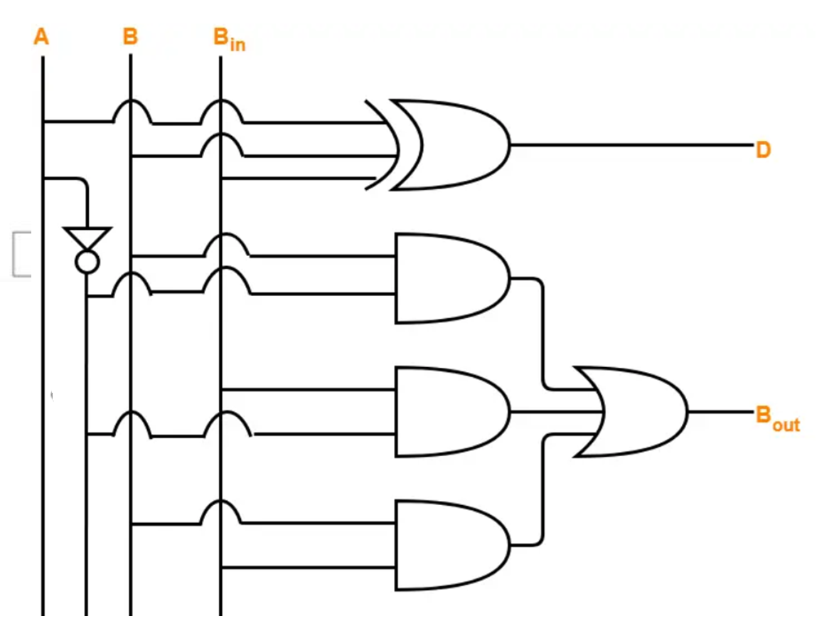

Slide 29
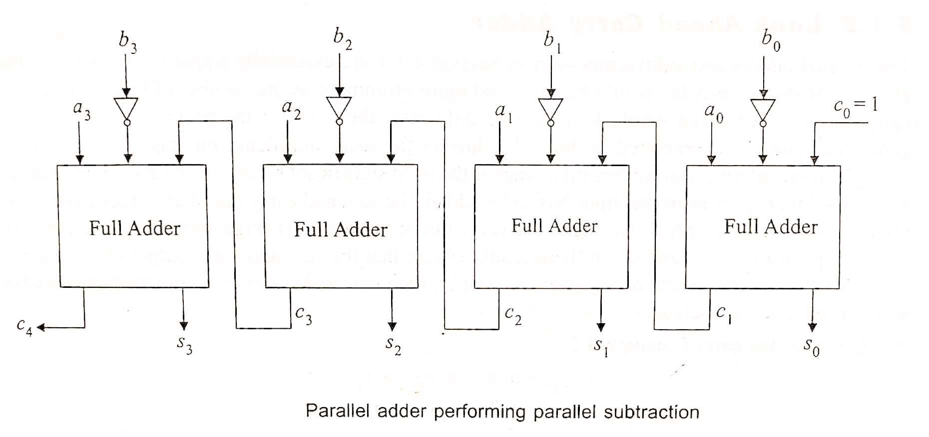
Parallel Subtractor

Slide 30
Working of Parallel Subtractor
The parallel binary subtractor is formed by combination of all full adders with subtrahend complement input.
This operation considers that the addition of minuend along with the 2’s complement of the subtrahend is equal to their subtraction.
Firstly the 1’s complement of B is obtained by the NOT gate and 1 can be added through the carry to find out the 2’s complement of B. This is further added to A to carry out the arithmetic subtraction.
The process continues till the last full adder uses the carry bit to add with its input A and 2’s complement of B to generate the last bit of the output S3 along last carry bit C₄.

Slide 31
For Subtraction
For a>b, a=b
If a carry is generated (C4=1) , then ignore the carry and result will be the difference between a and b.
For a<b
If no carry (C4=0), then the difference is 2’s compliment of the result with negative sign

Slide 32
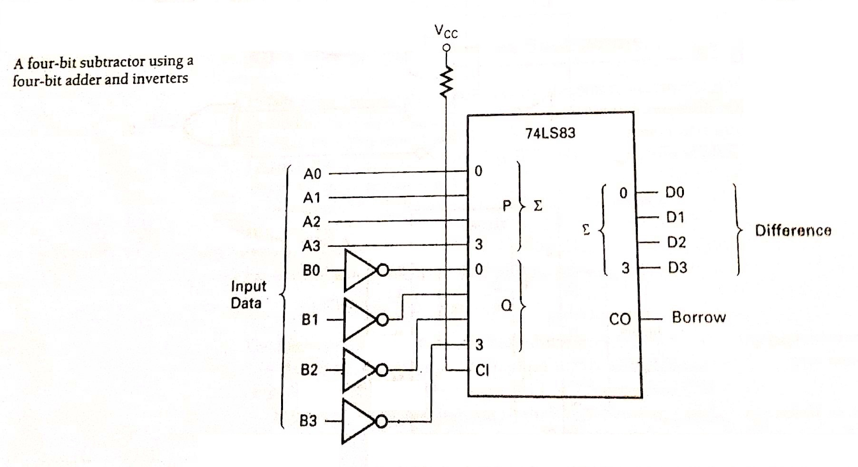

Slide 33
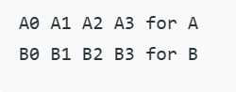
4-bit Parallel Adder/Subtractor
In Digital Circuits, a Binary adder/subtractor is capable of both the addition and subtraction of binary numbers in one circuit itself.
The operation is performed depending on the binary value the control signal holds. It is one of the components of the ALU (Arithmetic Logic Unit).
Let’s consider two 4-bit binary numbers A and B as inputs to the Digital Circuit for the operation with digits
The circuit consists of 4 full adders since we are performing
operations on 4-bit numbers. There is a control line M that
holds a binary value of either 0 or 1 which determines that
the operation is carried out is addition or subtraction.

Slide 34
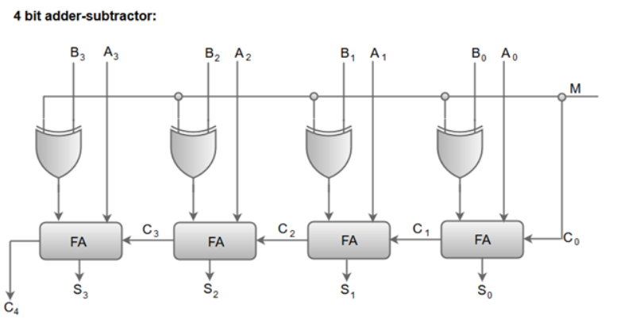

Slide 35
When the mode input (M) is at a low logic, i.e. '0', the circuit acts as an adder and when the mode input is at a high logic, i.e. '1', the circuit acts as a subtractor.
The exclusive-OR gate connected in series receives input M and one of the inputs B.
When M is at a low logic, we have B⊕ 0 = B. The full adders receive the value of B, the input carry is 0, and the circuit performs A plus B.
When M is at a high logic, we have B⊕ 1 = B' and C0 = 1. The B inputs are complemented, and a 1 is added through the input carry. The circuit performs the operation A plus the 2's complement of B.

Slide 36
Examples
M=0: A = 0001,B = 0000
S = 0001, C4= 0
M=0: A = 0010,B = 0100
S = 0110, C4 = 0
M=0: A = 1011,B = 0110
S = 0001, C4 = 1
M=1: A = 0001,B = 0000
S = 0001,C4= 1
M=1: A = 0010, B = 0100
S = 1110, C4= 0
M=1: A = 1011, B = 0110
S = 0101, C4 = 1
M=1: A = 0101, B = 0011
S = 0010, C4= 1

Slide 37
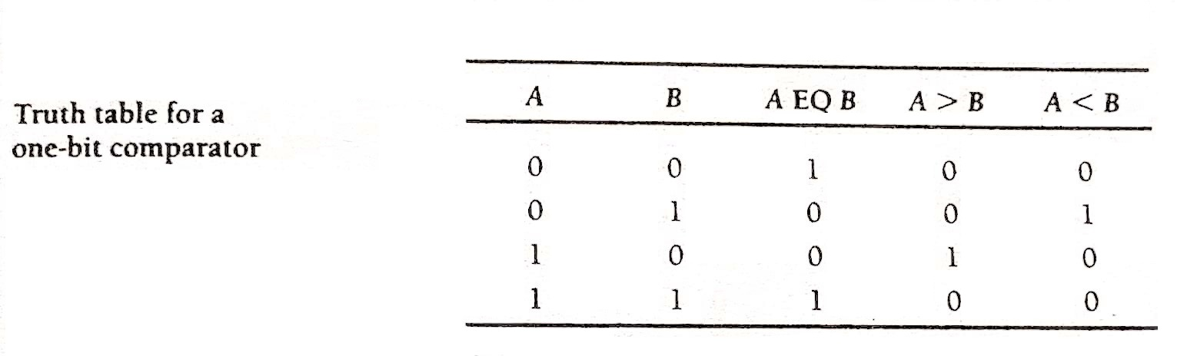
1-bit comparator

Slide 38
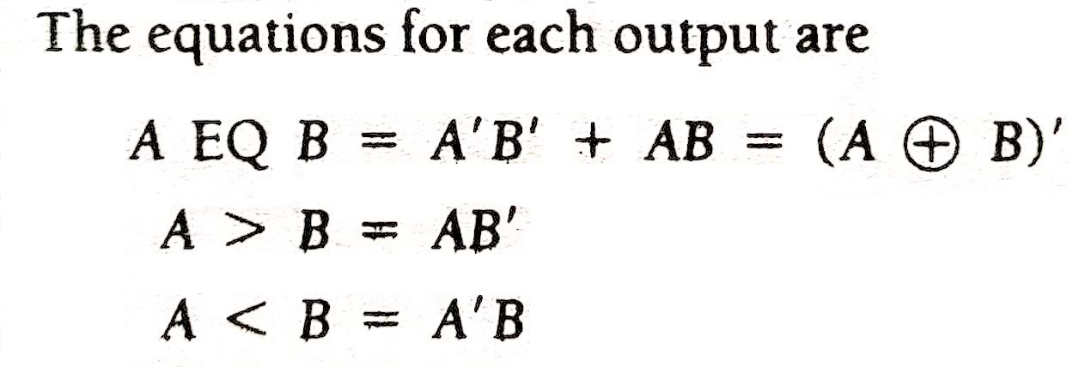

Slide 39
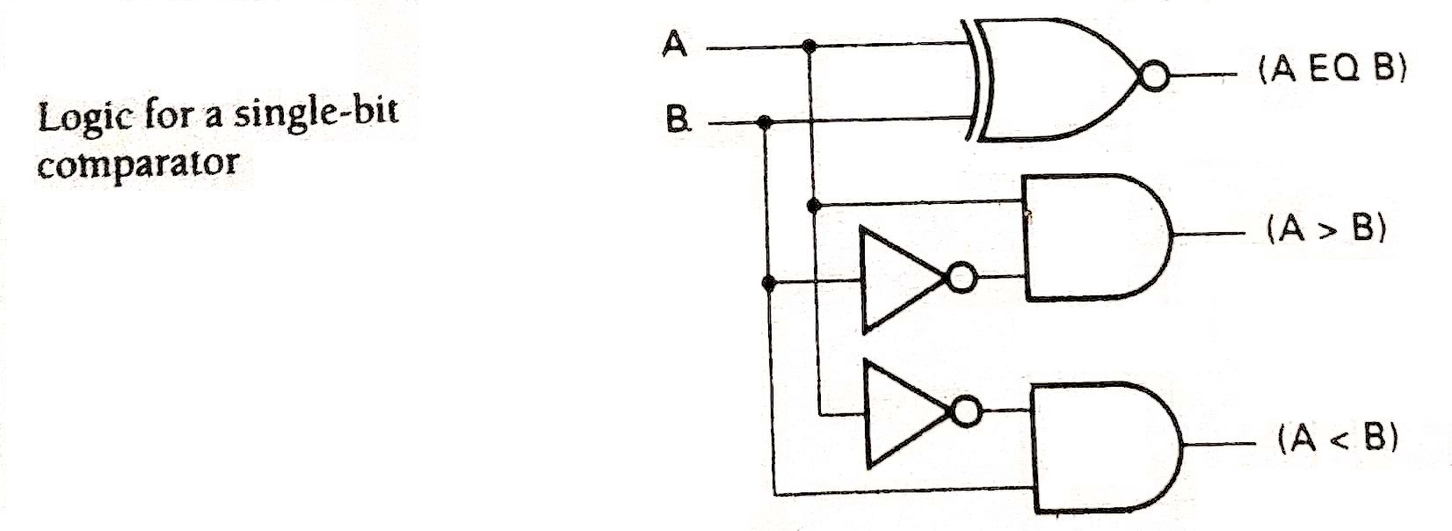

Slide 40
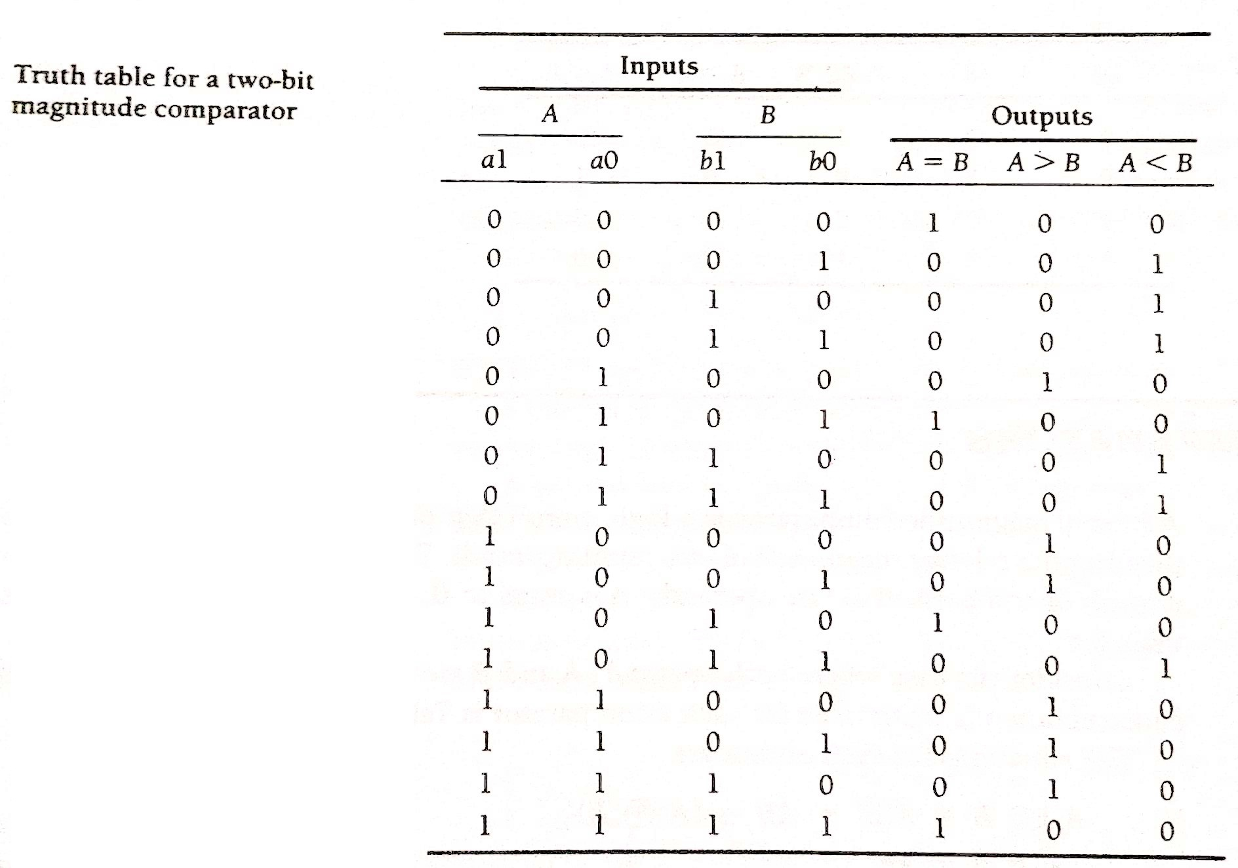
2- bit comparator

Slide 41
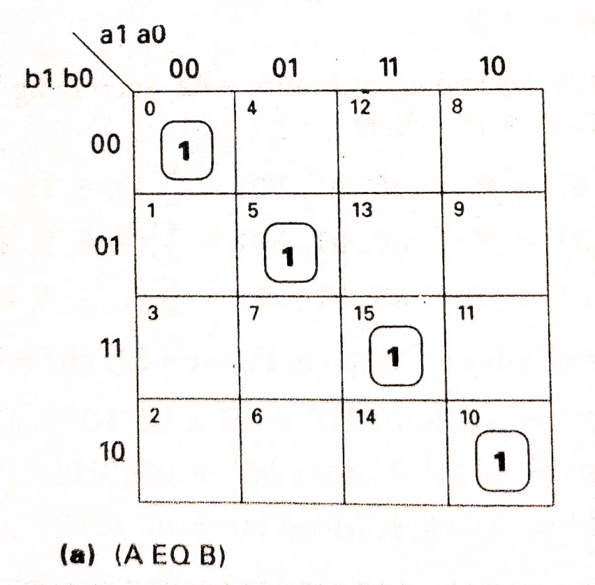
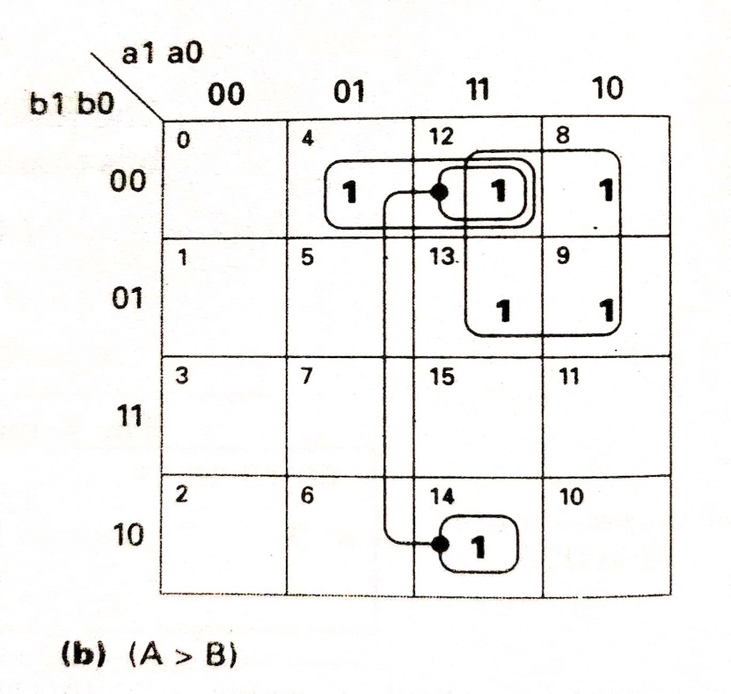
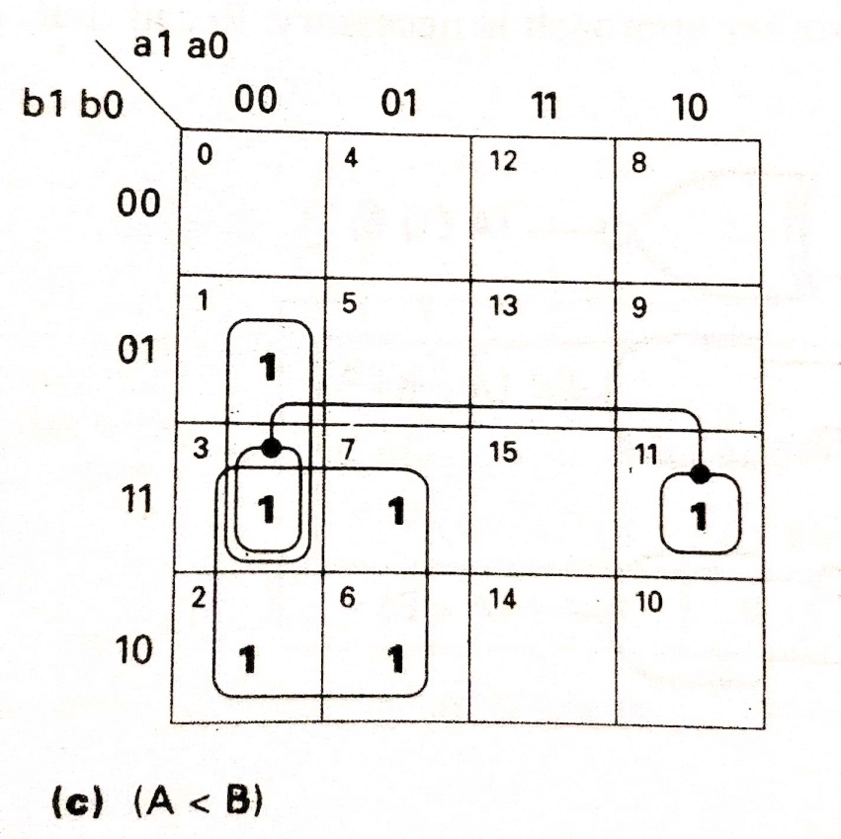

Slide 42
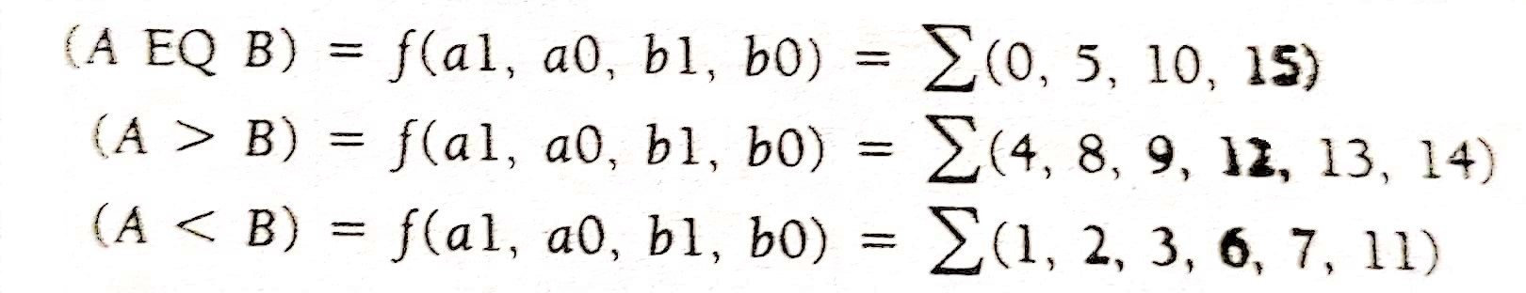
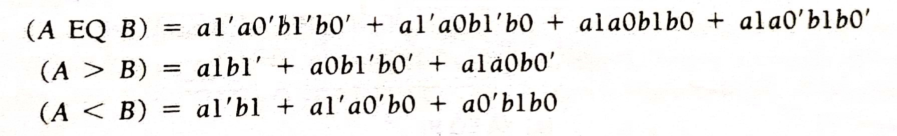

Slide 43
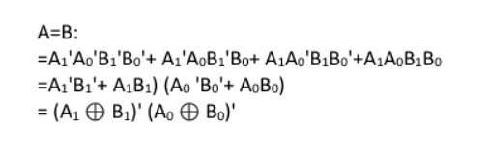


Slide 44


Slide 45





Multiplexer(MUX)

Slide 46

Application of MUX

Slide 47




$Y=\overline{S}I_{0}$+S $I_{1}$

Slide 48



4:1 Multiplexer
$$Y= \overline{B}\overline{A} D_{0}+\overline{B} A D_{1}+B\overline{A} D_{2}+BA D_{3}$$

Slide 49



8:1 Multiplexer

Slide 50

8:1 Multiplexer

Slide 51


Slide 52

Implement the following function using 4:1 MUX

Slide 53

a | b | c | f
0 | 0 | 0 | 1 | 1
0 | 0 | 1 | 1
0 | 1 | 0 | 1 | C’
0 | 1 | 1 | 0
1 | 0 | 0 | 0 | 0
1 | 0 | 1 | 0
1 | 1 | 0 | 0 | c
1 | 1 | 1 | 1

Slide 54



Slide 55

Implement the following function using 4:1 MUX, use b and c as select lines
a | b | c | f
0 | 0 | 0 | 0
0 | 0 | 1 | 1
0 | 1 | 0 | 0
0 | 1 | 1 | 0
1 | 0 | 0 | 1
1 | 0 | 1 | 1
1 | 1 | 0 | 0
1 | 1 | 1 | 1
a | b | c | f
0 | 0 | 0 | 0 | a
1 | 0 | 0 | 1
0 | 0 | 1 | 1 | 1
1 | 0 | 1 | 1
0 | 1 | 0 | 0 | 0
1 | 1 | 0 | 0
0 | 1 | 1 | 0 | a
1 | 1 | 1 | 1

Slide 57


Slide 58

Encoder
An Encoder is a combinational circuit that performs the reverse operation of a Decoder.
It has a maximum of 2^{n} input lines and ‘n’ output lines, hence it encodes the information from 2^{n} inputs into an n-bit code.
It will produce a binary code equivalent to the input, which is active High.
Therefore, the encoder encodes 2^{n} input lines with ‘n’ bits.

Slide 59

Example of Encoder

Slide 60




4x2 Encoder

Slide 61

8x3 Encoder (Octal to Binary encoder)
outputs
inputs

Slide 62

A2 = Y7 + Y6 + Y5 + Y4
A1 = Y7 + Y6 + Y3 + Y2
A0 = Y7 + Y5 + Y3 + Y1

Slide 63


Slide 64

Decoder
The combinational circuit that change the binary information into 2^{N} output lines is known as Decoders.
The binary information is passed in the form of N input lines.
The output lines define the 2^{N}-bit code for the binary information.
In simple words, the Decoder performs the reverse operation of the Encoder.
At a time, only one input line is activated for simplicity. The produced 2^{N}-bit output code is equivalent to the binary information.

Slide 65


2 to 4 decoder with active high outputs

Slide 66

3 to 8 decoder with active high outputs

Slide 67

Truth Table of 3:8 decoder

Slide 68


Slide 69


Slide 70


Slide 71


Slide 72


Slide 73


Slide 74


Slide 75


Slide 76


Slide 77


Slide 78


Slide 79
Additional Problem Statements

Slide 80

BCD to Excess-3 Conversion

Slide 81


Slide 82


Slide 83
The final set of output equations are
W= A + BD + BC
X = B’C + B’D + BC’D’
Y = C’D’ + CD
Z = D’

Slide 84

Excess-3 to BCD

Slide 85

Excess-3 code is also a Self complementing code

Slide 86

Binary to gray code conversion

Slide 87

Binary to gray code conversion

Slide 88


Slide 89


Slide 90

Gray to Binary code conversion

Slide 91

Gray code is also called unit distance code

Slide 92

Binary Multiplier

Slide 93


Slide 94


Slide 95


Slide 96


Slide 97


